Slide 1


UI Development
by Prompting
From Idea to Full-Stack App with Lovable AI
A Complete, Step-by-Step

Slide 2






Agenda & Roadmap
Lovable Basics
Prompt Strategy
Full Stack
Understanding the AI app builder and interface.
Mastering meta-prompting and visual editing.
Integrating Supabase, Auth, and GitHub.
OBJECTIVE
We will journey from "Hello World" to a fully deployed application with a live database.

Slide 3


The "Old" Way
Traditional Development Friction
•
High Barrier: Requires deep syntax knowledge.
•
Slow Cycles: Write Code → Save → Compile → Refresh.
•
The Disconnect: Figma designs rarely match the final code perfectly.
WHY WE ARE HERE
To eliminate the setup fatigue and syntax errors that slow down creativity.

Slide 4

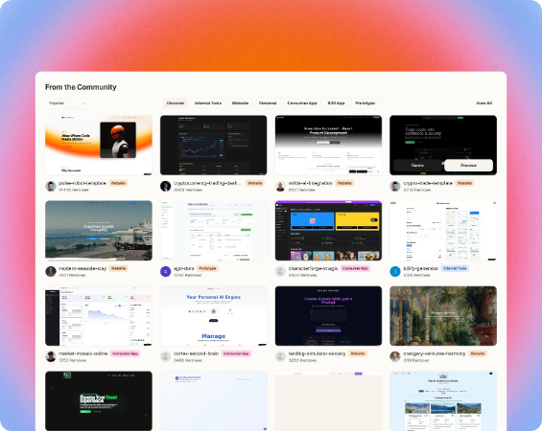
What is Lovable?
•
AI App Builder: Generates full-stack web apps from natural language.
•
Real Tech Stack: Builds on React, Tailwind, and Node.js.
•
No Lock-in: It generates real code you can export and own.
•
Iterative: Works best when you build in small steps.
KEY DIFFERENTIATOR
This isn't a mockup tool. It builds functional, deployable software.

Slide 5





The Workflow at a Glance
Plan
Prompt
Iterate
Connect
Deploy
PROCESS
We will follow this cyclical nature of building, refining, and connecting.

Slide 6
Setup & Credits
•
Access: Go to and sign in.
•
Economy: Every generation costs "Credits".
•
Strategy: Bigger builds cost more; small edits cost less.
•
Tiers: Paid plans unlock private projects and the built-in Code Browser.
LOGISTICS
Efficient prompting saves credits. Think before you generate.

Slide 7

The Golden Rule: Plan First
Checklist before prompting:
1.
Define MVP: What is the core function?
Blank Page Syndrome
2.
Structure: List the required pages.
If you don't know what you want, the AI cannot guess it.
3.
Aesthetics: Define colors and tone.

Slide 8
Case Study: Personal Portfolio Website

Slide 9
Drafting the First Prompt
Bad Prompt: "Make a fitness app."
PROMPT
orange + black
SPECIFICITY
Notice the specific keywords: Inputs, Logic, Theme, and Constraints.

Slide 10
Running the Build
Generating...
Lovable interprets the prompt and writes the React/Tailwind code in real-time.
EXPECTATION MANAGEMENT
The first generation is a "Draft," not the final product.

Slide 11





Interface Tour: Left Panel
Chat Input
History
Knowledge
Your main communication line with the AI.
Version control to undo mistakes.
Persistent context and rules (covered later).

Slide 12


Interface Tour: Right Panel
Live Preview
•
Live Preview: Real-time rendering of your app.
•
Device Toggles: Switch between Desktop, Tablet, and Mobile.
•
Route Picker: Navigate between pages (e.g., /home, /login).
Tip: Always test responsiveness immediately.

Slide 13




Build Mode vs. Chat Mode
Chat Mode
Default (Build)
Lovable answers questions and plans. It does NOT change code.
Lovable acts and modifies the project code directly.
WORKFLOW
Use Chat Mode to think, Default Mode to build.

Slide 14
Visual Editing
Point and Click
You don't always need to describe the whole app. Click an element to target it.
MICRO-ADJUSTMENTS
Targeted edits prevent the AI from hallucinating changes elsewhere in the app.

Slide 15
The History Tab
•
Safety Net: Every prompt creates a save point.
•
Restore: If a prompt breaks the app, jump back to the previous state instantly.
•
Code Diff: (Paid) See exactly what lines of code the AI changed.
CONFIDENCE
Encourages experimentation because you can always "undo".

Slide 16


Testing the MVP
Quality Assurance
•
Input real data into the forms.
•
Verify the math logic (Calculators often fail first try).
AI makes logic errors. Always verify.
•
Check button states and navigation.

Slide 17
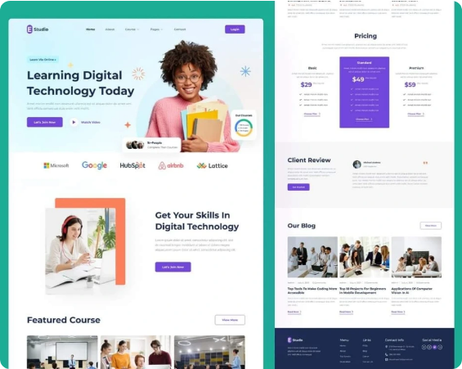
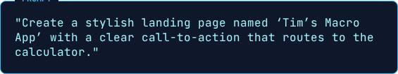

Adding a Landing Page
Prompt Strategy
This creates a new route (e.g., vs ).

Slide 18
Meta-Prompting
Using AI to Write AI
1.
Switch to Chat Mode.
2.
Ask: "Help me craft a clear prompt to add a site-wide dark mode toggle."
3.
Copy the result.
4.
Paste into Build Mode.
THE SECRET WEAPON
When you don't know the technical terms, let the AI write the instructions for you.

Slide 19


The "Sandwich" Method
TOP: Context & Constraints
"I want a dark/light mode toggle..."
MIDDLE: The Request
"...implement using Tailwind classes..."
BOTTOM: Critical Constraints
"...Ensure it persists on refresh."

Slide 20
External Components
21st.dev Workflow
•
Source: Find a component on 21st.dev.
•
Copy: Copy the provided detailed prompt/code.
•
Paste: Add to Lovable with a locator:
EFFICIENCY
Don't reinvent the wheel. Use pre-made, high-quality component prompts.

Slide 21


Animations & Motion
Adding "Juice"
Prompt for "Hero Animations" or "Fade-in effects" to make the app feel alive.
Warning: Complex animations can impact performance. Always check mobile responsiveness.

Slide 22



Project Knowledge
Persistent Context
Define global rules the AI must always follow.
Rule 1
Rule 2
Rule 3
"Always support Dark Mode."
"Use rounded corners (20px)."
"Primary Brand Color is #FF5733."
CONSISTENCY
Prevents you from repeating the same style instructions in every single prompt.

Slide 23
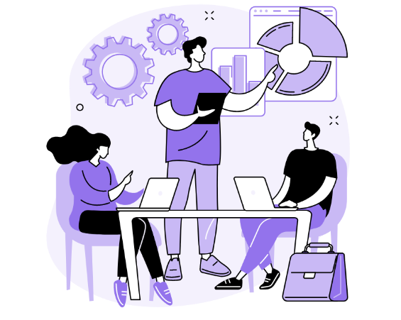
Design to Code
Image Upload
•
Upload a screenshot or Figma export.
•
Prompt: "Make the layout look exactly like this image."
•
Lovable analyzes the visual structure and replicates it in code.

Slide 24

Version Control
Moving beyond "toy" apps

Slide 25

Connecting GitHub
Setup Steps
1.
Click the Sync to GitHub button in header.
2.
Connect your GitHub account.
3.
Create a new repository.
This ensures you have a backup and true ownership of your code.

Slide 26


Two-Way Sync
Lovable → GitHub
GitHub → Lovable
Push changes from the AI builder to your repo.
Edit code in VS Code, push to Git, and Lovable updates its preview.

Slide 27
Troubleshooting Sync
The "Blank Preview" Bug
Sometimes connecting Git can reset the preview state.
SELF-HEALING
Lovable can usually diagnose its own build errors if prompted correctly.

Slide 28
Code Export
No Vendor Lock-in
•
You can download the full source code as a ZIP.
•
Stack: Vite, React, Tailwind CSS, Supabase.
•
You can host this code on Vercel, Netlify, or AWS without Lovable.

Slide 29
The Backend
Database, Auth, and Edge Functions

Slide 30
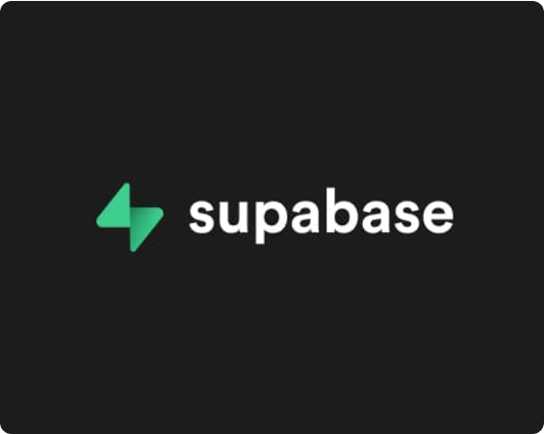
Integrating Supabase
One-Click Connect
1.
Click the Supabase icon in Lovable.
2.
Create a new project (Select Region).
3.
Set a database password.
This provisions a full Postgres database connected to your app.

Slide 31
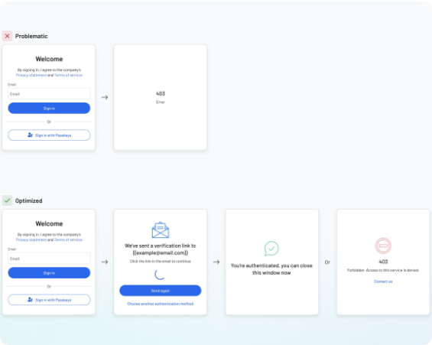

Authentication Flow
User Management
Lovable will auto-generate the Login/Register forms and handle the Supabase Auth logic.

Slide 32
Protecting Routes
Access Control
PROMPT
Test Strategy: Try to access the URL in an Incognito window. You should be redirected to Login.

Slide 33

Database Logic & Migrations
Persistence
Migrations
Lovable will generate SQL migrations. Review them (check table names/fields) before clicking "Apply".

Slide 34
Row Level Security (RLS)
Data Privacy
Concept: "Users can only see their own data."
CRITICAL
Without RLS, any user could potentially query the entire database.

Slide 35
Building a History Feature
Connecting Frontend to Backend
This confirms the read/write loop is working: App → DB → App.

Slide 36




Supabase "Gotchas"
Email Confirmation
RLS Blocks
Sign-in might fail if the user hasn't verified their email (default Supabase setting).
If data won't save, check if the RLS policy allows "INSERT" for authenticated users.

Slide 37
Profiles & User Data
Advanced Data Modeling
•
Auth table is private. You need a public profiles table for avatars/names.
•
Prompt: "Create a profiles table linked to auth.users. Add avatar_url and username."

Slide 38
Pre-Deployment Checklist
Test all routes (Login, Home, App).
Check mobile responsiveness.
Verify Auth flow (Sign up new user).
Check Browser Console for red errors.

Slide 39

Publishing
Lovable builds the production assets and deploys to a hosted URL (lovable.app).

Slide 40
Custom Domains & SEO
Professional Polish
•
Domains: Configure in Project Settings (CNAME records).
•
SEO Prompt: "Add meta description and title tags for SEO optimization."
•
Social: "Add Open Graph tags for social media sharing cards."

Slide 41
Debugging Tactics
When things break...
1.
Paste Errors: Copy the red error text into Chat.
2.
Ask "Why": "Why is the login button not responding?"
3.
Isolate: Revert the last change (History) to see if that fixes it.
PROBLEM SOLVING
Treat the AI as a junior developer. It needs clear error reports to fix bugs.

Slide 42


Continuous Improvement
Analytics
Feedback
Prompt to add Google Analytics or PostHog.
Gather user feedback and iterate.

Slide 43
Cost Management
Sustainability
•
Monitor Credits: Check your Lovable balance daily.
•
Supabase Limits: Be aware of the Free Tier limits (Database size, Monthly Active Users).
•
Efficiency: Combine small edits into one prompt to save credits.

Slide 44



Summary of Capabilities
Prompt → UI
Prompt → DB
Prompt → Auth
Prompt → Deploy
A single person can now execute the work of a full stack team.

Slide 45
Build your first app today.
lovable.dev
Start small. Iterate fast. Deploy often.

Slide 46






Image Sources
https://img.freepik.com/premium-photo/software-technician-frustrated-while-updating-complex-binary-code_482257-88326.jpg
Source: www.freepik.com
https://madewith-app-prod-bucket.s3.eu-west-3.amazonaws.com/posts/lovable-07-16-2025_10_43_am.jpg
Source: madewithlovable.com
https://cdn.dribbble.com/userupload/44121881/file/original-8a86f54abf60fa4884031b9a7f2996e9.png?crop=696x96-4288x2790&format=webp&resize=400x300&vertical=center
Source: dribbble.com
https://static.vecteezy.com/system/resources/thumbnails/066/833/181/small/cyber-engine-background-with-dark-circuit-grid-black-tech-layout-with-fine-digital-lines-ideal-for-cyber-themes-security-and-futuristic-ui-elegant-modern-structure-bg-illustration-vector.jpg
Source: www.vecteezy.com
https://res.cloudinary.com/upwork-cloud/image/upload/c_scale,w_1000/v1708031489/catalog/1528346415018852352/rzx40yuicocqdyrxxjvm.webp
Source: www.upwork.com
https://render.fineartamerica.com/images/rendered/default/greeting-card/images/artworkimages/medium/2/space-rocket-denny-h.jpg?&targetx=0&targety=0&imagewidth=500&imageheight=700&modelwidth=500&modelheight=700&backgroundcolor=020734&orientation=1
Source: pixels.com

Slide 47




Image Sources
https://www.shakebugs.com/wp-content/uploads/2022/05/Benefits-of-teamwork-and-collaboration-for-software-development-teams.png
Source: www.shakebugs.com
https://github.blog/wp-content/uploads/2025/04/darklight.png
Source: github.blog
https://supabase.com/_next/image?url=https%3A%2F%2Ffrontend-assets.supabase.com%2Fwww%2F6d2bb4aa2b2e%2F_next%2Fstatic%2Fmedia%2Flogo-preview.50e72501.jpg&w=3840&q=75
Source: supabase.com
https://www.descope.com/_next/image?url=https%3A%2F%2Fimages.ctfassets.net%2Fxqb1f63q68s1%2F6gSU2boSSDJU3G6TJuK4L4%2F207467056a922e8b3d881f41830cfd95%2FTip_3__1_.jpg&w=3840&q=75
Source: www.descope.com

